Slide 1
INTRODUCTION TO ELECTRICAL ENGINEERING
TERM PROJECT

Slide 2

TEAM
BATCH-A​ | TEAM-7​
GAJULA SRI VATSANKA​ | CB.EN.U4AIE.21010​
GUNNAM HIMAMSH​ | CB.EN.U4AIE.21014​
M.PRASANNA TEJA​ | CB.EN.U4AIE.21035​
VIKHYAT BANSAL​ | CB.EN.U4AIE.21076​

Slide 3
QUESTION
Design and Set up a Single-slope and Dual-slope ADC

Slide 4
WHAT IS ADC ?

Slide 5
ADC
We use an ADC to convert an ANALOG signal(such as Microphone collecting sound) to DIGITAL signal.
Full form of ADC is "ANALOG-TO-DIGITAL CONVERTER".
Application of ADC: -
Used together with the transducer.
Used in computer to convert the analog signal to digital signal.
Used in cell phones.
Used in microcontrollers.
Used in digital signal processing.
Used in digital storage oscilloscopes.
Used in scientific instruments.
Used in music reproduction technology.

Slide 6
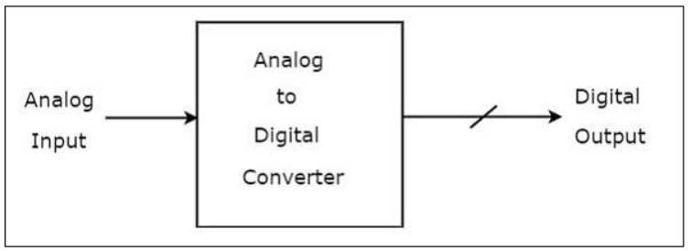
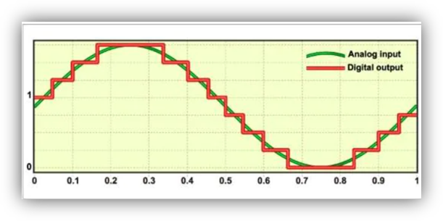
Block Diagram of ADC

Slide 7
Types of ADC
Few Types of ADC
Flash-Type
Counter-Type
Successive approximation
Dual-Slope
Single-Slope

Slide 8

RESOLUTION
The LSB of the ADC gives the Resolution as
Example: -
For a linear 6-bit ADC with 1V full-scale
Resolution is = ½^6 = 0.0156

Slide 9
01
SINGLE SLOPE ADC
You can enter a subtitle here if you need it

Slide 10
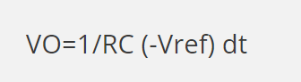
SINGLE-SLOPE
VO=1/RC (-Vref) dt
The input voltage is applied to the positive terminal of the comparator while the reference voltage is obtained after being integrated through the integrator.
Both of the voltages get compared through the comparator. The input voltage is a function of time t.
The reference voltage keeps on integrated until the output voltage of the comparator becomes equal to the input voltage.
The general output voltage of the integrator is given as:-
APPLICATIONS:
Used in Temperature Transducers
Used in Digital multimeters

Slide 11
Components in a Single Slope ADC
OPAMP
Integrator created using OPAMP
Comparator using OPAMP
Counter Logic
Counter
Clock
Counter [4-Bit] with reset PIN

Slide 12
Explanation
Integrator: -In the dual-slope technique, an integrator is used to integrate an accurate voltage reference for a fixed period of time. The same integrator is then used to integrate with the reverse slope, the input voltage, and the time required to return to the starting voltage is measured.
Comparator:- Comparator compares the output of the integrator with zero volts (ground) and produces an output, which is applied to the control logic.

Slide 13
Counter and control logic
Counter: - The counter gets incremented by one for every clock pulse and its value will be in binary (digital) format. It produces an overflow signal to the control logic, when it is incremented after reaching the maximum count value. At this instant, all the bits of counter will be having zeros only.
Control Logic: -The control logic resets the counter and enables the clock signal generator in order to send the clock pulses to the counter, when it is received the start commanding signal.
Control logic pushes the switch sw to connect to the external analog input voltage Vi, when it is received the start commanding signal. This input voltage is applied to an integrator.

Slide 14
Working principle
In this type, we generate a sawtooth waveform using an op-amp as an integrator.
The output of sawtooth waveform is compared against the analog input using a comparator circuit to generator a digital output.
They have a high resolving power but are quite slower in terms of conversion speed than other analog to digital converters. Its major application is in the multimeter.
The counter is reset to zero before converting the analogue input to binary output.
The comparator receives both the input voltage and an integrated reference voltage.

Slide 15
The reference voltage is initially lower than the input voltage when the conversion starts.
The counter receives clock pulses because of the comparator's high output, which causes the counter to function and count.
As a result, the comparator switches from a high to a low state when the integrated reference voltage reaches the applied input voltage.
The AND gate's output drops, the counter no longer receives clock pulses, and the counter stops counting.

Slide 16
Whatever the case, the counter will then display a count that is proportionate to the input voltage.
The circuit also has a switch called the Reset Switch.
When the comparator's output is low, it quickly closes, ensuring that there is no residual charge across the capacitor to prevent errors.
This is the method by which the given analogue signal is converted to the digital output signal by the single slope analogue to digital converter.
The circuit is also accompanied by a switch known as Reset Switch. It gets closed shortly when the comparator’s output is low and makes sure that there is no leftover charge across the capacitor to avoid any errors.

Slide 17
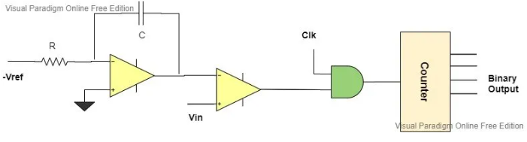
CIRCUIT DIAGRAM

Slide 18
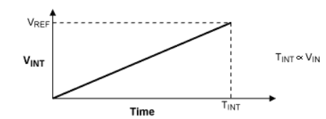
Graphical Representation

Slide 19
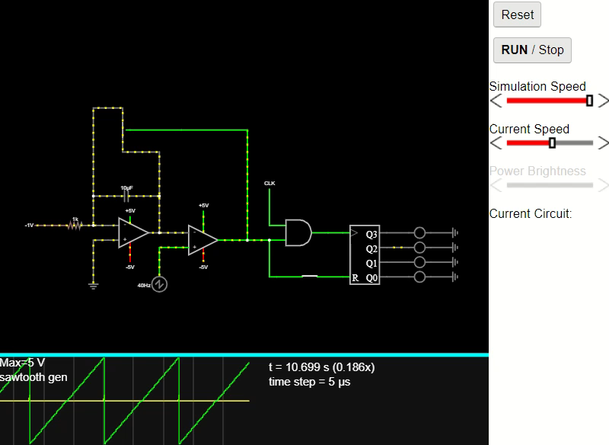
FALSTAD CIRCUIT [LINK]

Slide 20
The graphical representation depicts the effect on input voltage and resistance on the graph.
The above graph shows the time taken for the integration with respect to the applied input voltage.
The reference voltage and RC are constant that is why the slope i.e. Vref/RC is constant. The input voltage only affects the time.
Higher the input voltage, more time will be taken for the integration process while the slope remains the same.

Slide 21
Effect of R and C values on const input Voltage
Basically, R and C are the symbols of resistance and capacitance.
So, let us first see what basically Resistance and Capacitance mean ?
Capacitance and resistance are two of the most fundamental concepts in electronics.
Both will be present in every main circuits.

Slide 22
Resistance
The resistance in a qualitative definition tells us how hard it is for an electrical current to flow.
In the quantitative sense, the resistance between two points can be defined as the voltage difference that is required to take a unit current across the defined two points
Capacitance
The capacitance of an object is a measurement of the number of charges that object can hold without discharging.
Capacitance is an important property in both electronics and electromagnetism.
Capacitance is also defined as the ability to store energy in an electric field.

Slide 23
Difference b/w Resistance and Capacitance
Resistance is a value of the material itself while capacitance is a value of the combination of objects.
Resistance depends on temperature while capacitance does not.
Resistors behave similarly to both AC and DC, but capacitors act in two different manners.

Slide 24
Effect of R and C values on const input Voltage
If the input voltage remains constant but R or C vary, the slope changes.
Despite consistent input, we will attain a varying integration time.
Assume that lowering the R value reduces the time required by the integrator circuit to achieve the input voltage in magnitude.
This value of RC fluctuates over time owing to external variables such as temperature and thermal agitation, which is a key cause of its poor accuracy and brings us to its solution, a dual-slope analogue to digital converter.

Slide 25
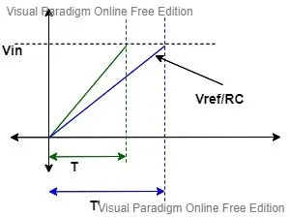
Graph

Slide 26
02
DUAL SLOPE ADC
You can enter a subtitle here if you need it

Slide 27
DUAL-SLOPE
The integrator generates two ramps, one with the known analogue input voltage and one with the known reference voltage -Vref.
As a result, it is known as a dual slope A to D converter.
APPLICATIONS:
Used in Temperature Transducers
Used in Digital multimeters

Slide 28
Parts of dual slope ADC
The dual slope ADC mainly consists of 5 blocks
Integrator
Comparator
Clock signal generator
Control logic
Counter

Slide 29
Working principle
The output of the integrator is linked to the comparator's negative terminal, while the positive terminal is grounded.
The integrator is connected to the input voltage at the beginning of the conversion.
When compared to the ground, the inverting terminal is negative with regard to the non-inverting terminal, which causes the comparator's output to become high.
The AND signal then sends clock pulses to the n-bit counter, which begins counting from zero and continues until overflow becomes 1.
The input signal is integrated by the counter in 2N clocks.

Slide 30
The switch automatically toggles and unites with the negative reference voltage when the overflow is detected.
The process is repeated as the integrator starts integrating in the positive direction when the reference voltage is negative.
This time, the counter will halt when the comparator's output becomes too low.
The binary output of the n-bit counter would then be directly proportional to the time T2 at that specific moment.
The dual-slope ADC does the conversion in this manner.

Slide 31
Advantages and disadvantages of dual slope ADC
Advantages :-
It provides better noise immunity than other ADC types.
It also has good accuracy.
The input signal is averaged.
Disadvantages
The accuracy demands highly precise external components.
The ADC slows down with the increase in the resolution that is why it is not used in data acquisition.

Slide 32
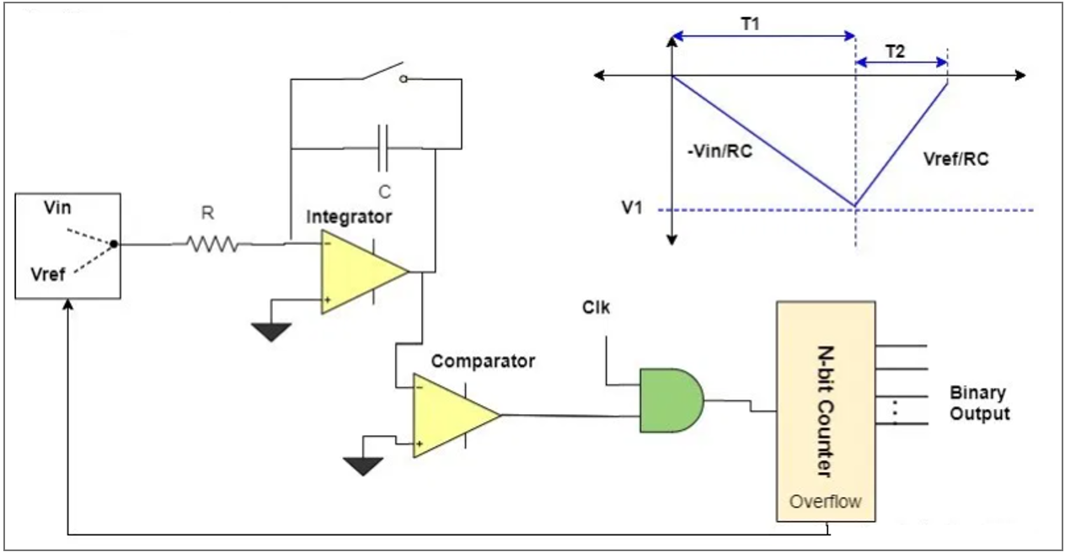
CIRCUIT DIAGRAM

Slide 33
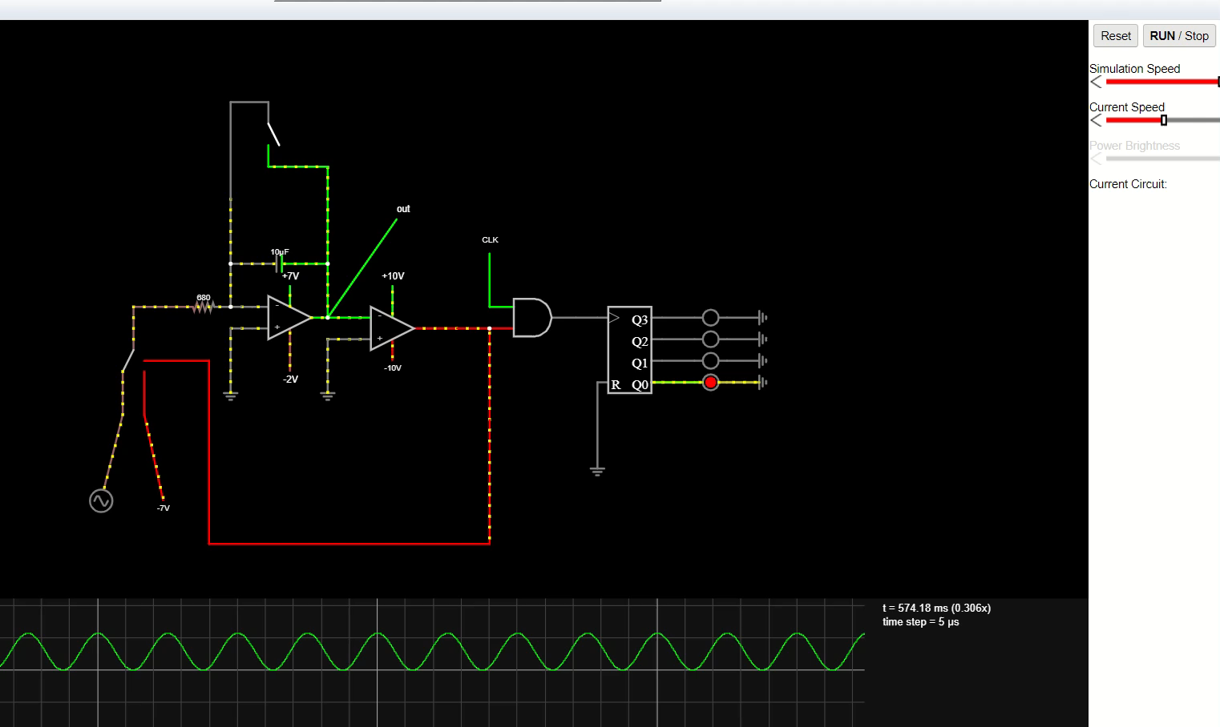
FALSTAD CIRCUIT [LINK]

Slide 34
Presentation Video [Video Link]

Slide 35
THANK YOU

